Slide 1

Department of Electrical Engineering Indian Institute of Technology, Bombay
Wadhwani Electronics Lab EE214
Session: 2023-24
Scan Chain Demo
Harsh Gupta ( 2nd year RA)

Slide 2
Objectives
Need for Scan Chain
Basic understanding of JTAG and Scan Chain
What is Virtual JTAG IP
How Scan Chain works
How to Run Scan Chain using virtual JTAG

Slide 3
Where did we left off?
Can We use this (Pin Planning) method to verify any design?
Possible Issues?
Number of Switches and LEDs are Limited
Amount of time to verify all input combination

Slide 4
Why Test on Hardware?
Already written a Testbench for verification
Verified Design through RTL Simulation
Hardware may have some timing Differences/ small faults.
Design may not be synthesizable(works only in simulation )
All simulated design may not work perfectly on board
Before releasing your design, need to confirm if it works on actual hardware or not.

Slide 5
Recap
Till now –
Written VHDL code for Full Adder, Multiplexer, Decoder etc.
Verified through a Testbench using a TRACEFILE (RTL Simulation)
Verified on Xenon board using Switches and LEDs
Number of input- output pins for Full Adder = 3/2, Prime/Fibonacci Detector = 5/1.

Slide 6
Why Scan Chain
4-bit Adder-Subtractor
Number of input/output Pins = 9/5
Available switches/LEDs on Xenon Board = 8/8
How to give inputs and Check output?
Time required to check for all input combinations? - 512 combinations for adder
Solution – Scan Chain
For a design with any number of input and output pins

Slide 7
Lets Develop a testing method
Can we use existing Tracefile?
Possible Solution :
send inputs through USB to FPGA
Allow FPGA to react to the inputs
Read outputs generated by FPGA through USB
Compare generated output with golden output

Slide 8
JTAG
Scan Chain based testing method became very popular
Industry standard for verifying designs and testing PCBs
Subsequently, used for uploading design on FPGA/CPLD boards.
So much that it became an IEEE standard – IEEE-1149.1
Joint Test Action Group – 1990
One stop Solution for Programming and testing.
Every IC has Basic JTAG hardware Built in it.
Different Manufacturers follow the same standard

Slide 9
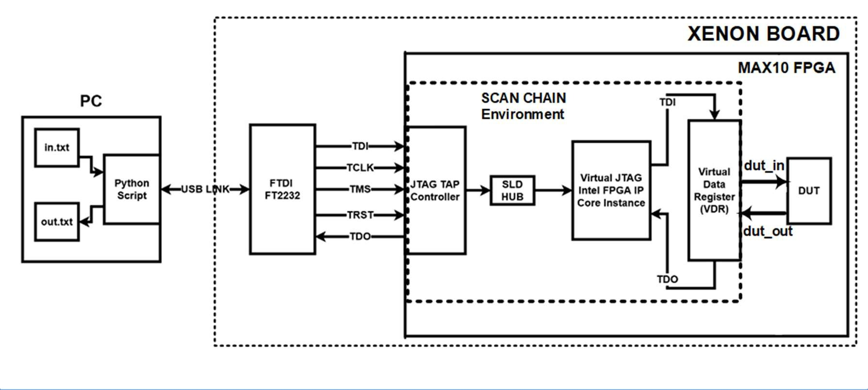
Virtual JTAG
FPGAs already have the basic JTAG Hardware built-in
To Control the basic hardware, need to write some VHDL code
Alternative - Virtual JTAG Intel FPGA IP Core
Intellectual Property: source code not visible

Slide 10
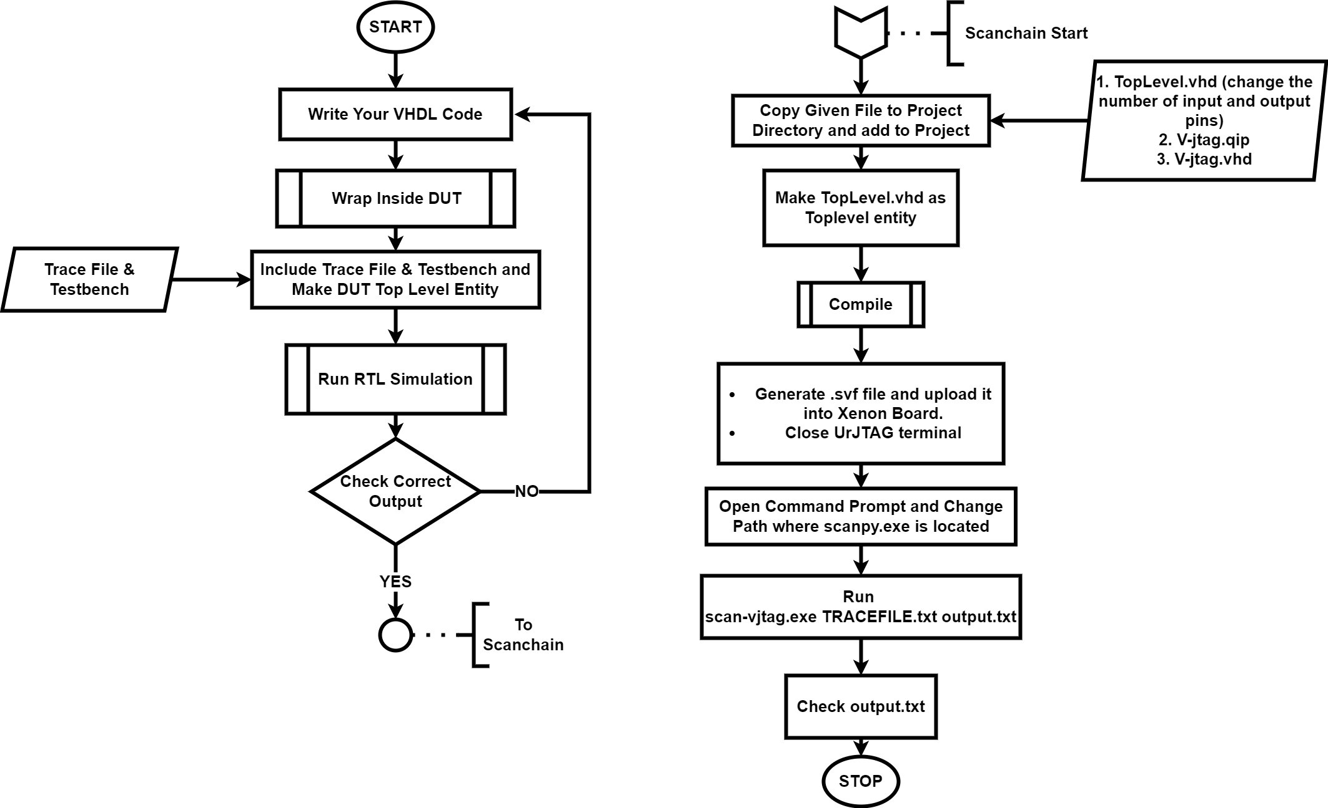
Design Flow

Slide 11
Steps to run Scan Chain
Install Python, PIP, Python Packages
Install Python 3.7 or Python 3.8
Install PIP
Install the following packages using the commands as shown
pip install bitstring
pip install ftd2xx
pip install pyusb

Slide 12
Setup Environment
Necessary files
DUT wrapped design file and other dependent design files with working RTL simulation
Tracefile
Files Required for Scan Chain (Shared)
TopLevel.vhd
Folder v_jtag
scan_vjtag.exe file
scan_vjtag.py
Copy these files and paste them in the project directory

Slide 13
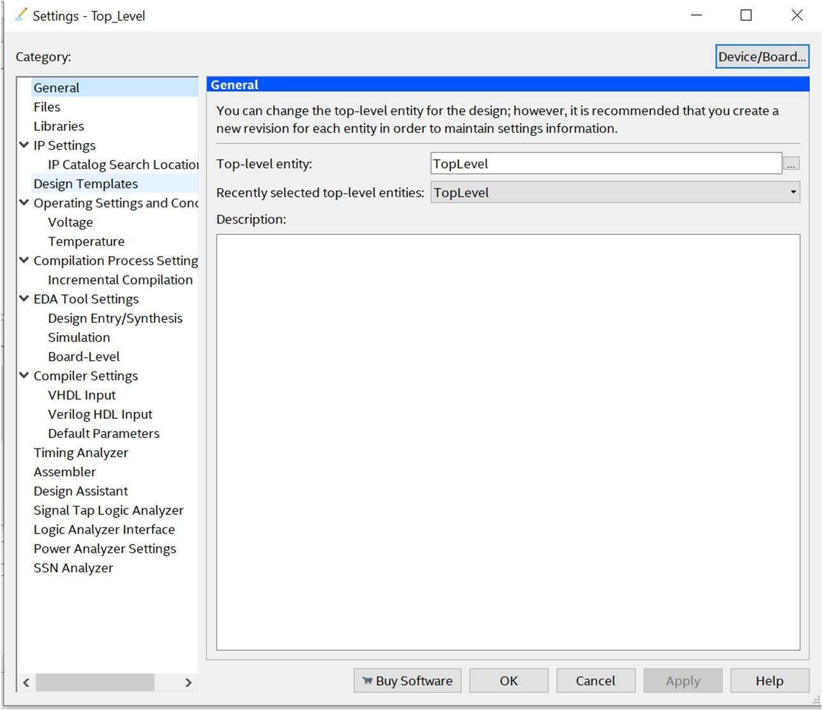
Modifications to Quartus Project
Modifications to Quartus Project
Add TopLevel.vhdl to the Quartus Project
Change the number of inputs and outputs
to the design
This change is the same as what was done
for testbench
Go to Assignments -> Settings -> General
Set top level entity as TopLevel as shown

Slide 14
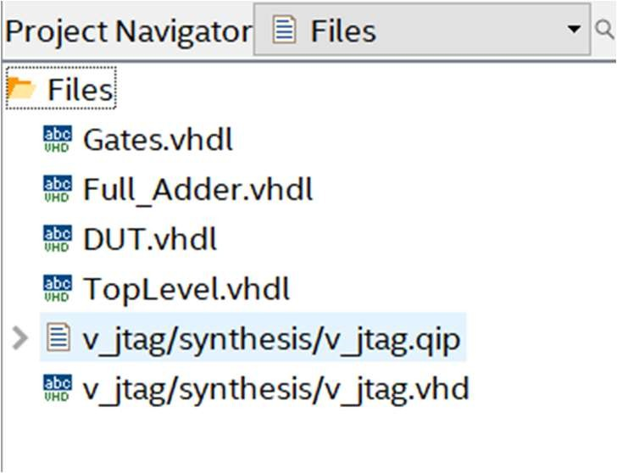
Modifications To Project
Add the following files in the path: v_jtag\synthesis
v_jtag.vhd
v_jtag.qip
For a sample full adder project, these are the list of files that have to be present
Note that the presence or absence of testbench in the project does not matter during scan chain

Slide 15
Upload SVF on Board
Note – Pin Planning is not needed.
Note – Keeping Testbench in project doesn't matter
Do a full compilation of the design (note you need to repeat the task since the top level entity has changed)
Generate SVF file again
Dump the SVF file on the Xenon Board
Close the Urjtag Terminal

Slide 16
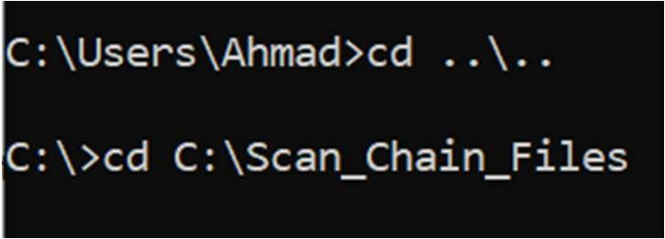
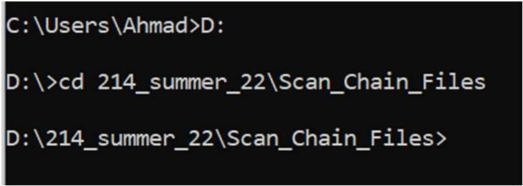
Run Scan Chain Python Script
Open Command Prompt and change path using cd command
In case the project is on C drive, use the following
cd ..\..
cd <absolute path of folder>
This path can be copied from windows explorer
In case you are in D/E/F drives, enter the following
D: or E: or F:
cd <absolute path of folder>

Slide 17
Run Scan Chain Python Script
Run the following command to observe the output
scan_vjtag.exe TRACEFILE.txt out.txt
scan_vjtag.exe is the name of the file to run
TRACEFILE.txt needs to be a text file in the specified format. It is an input to the exe file
In case you have renamed it, write the new file name in the command
out.txt is a file that is generated by the code. There need not be an existing file with the name. In case there is, the program will overwrite the file without warnings
Check out.txt to find whether your design has successfully passed all test cases or not

Slide 18
Frequently Encountered Errors
In case the .exe file is treated as a virus by your antivirus software, then give it permission by allowing the file in settings
If the issue still persists, the scan_vjtag.py file is provided as backup
Verify installation of the pip packages in slide 12 (enter installation command again and you will get something similar to the following if it is installed successfully)
Repeat all steps until the command scan_vjtag.exe TRACEFILE.txt out.txt
Enter the following command instead of that
python scan_vjtag.py TRACEFILE.txt out.txt

Slide 19
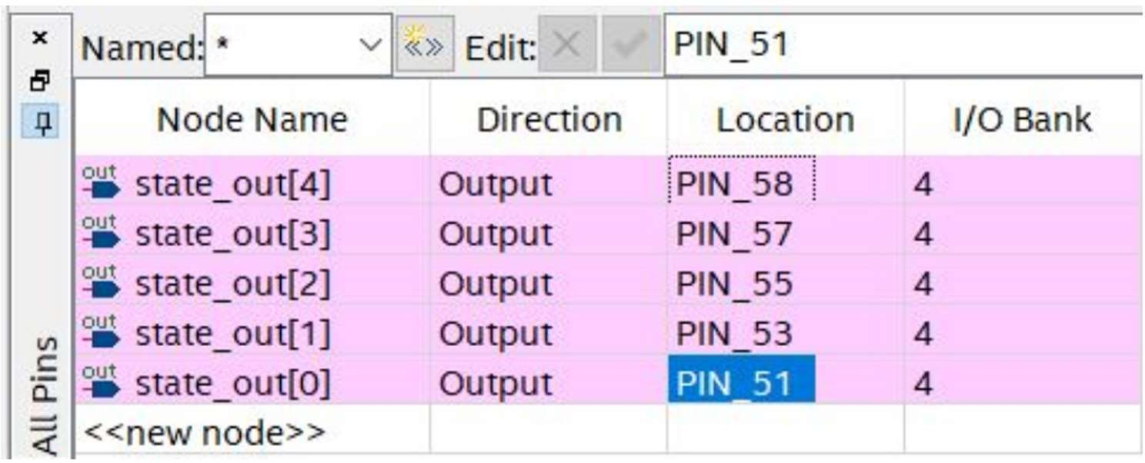
Frequently Encountered Errors
In case Quartus throws an error unrelated to your design, then do the following
Verify the port names in v_jtag.vhd with the component declared in TopLevel.vhd
Before dumping the SVF file, open pin planner and map it as shown in image (also mentioned in comments of TopLevel.vhdl
Compile design again, and proceed from slide 16

Slide 20
Difference between verification using Testbench and Scan-Chain
Testbench -
Hardware is Simulated and design's functionality is checked
Scan-Chain -
Actual hardware is given the inputs and Outputs are then compared

Slide 21
Questions?

